Slide 1

Brockport High School
Student Parking 2023-24
** You Must Complete a Short Quiz after reviewing the PPT at the very end.
Click here to access the quiz

Slide 2
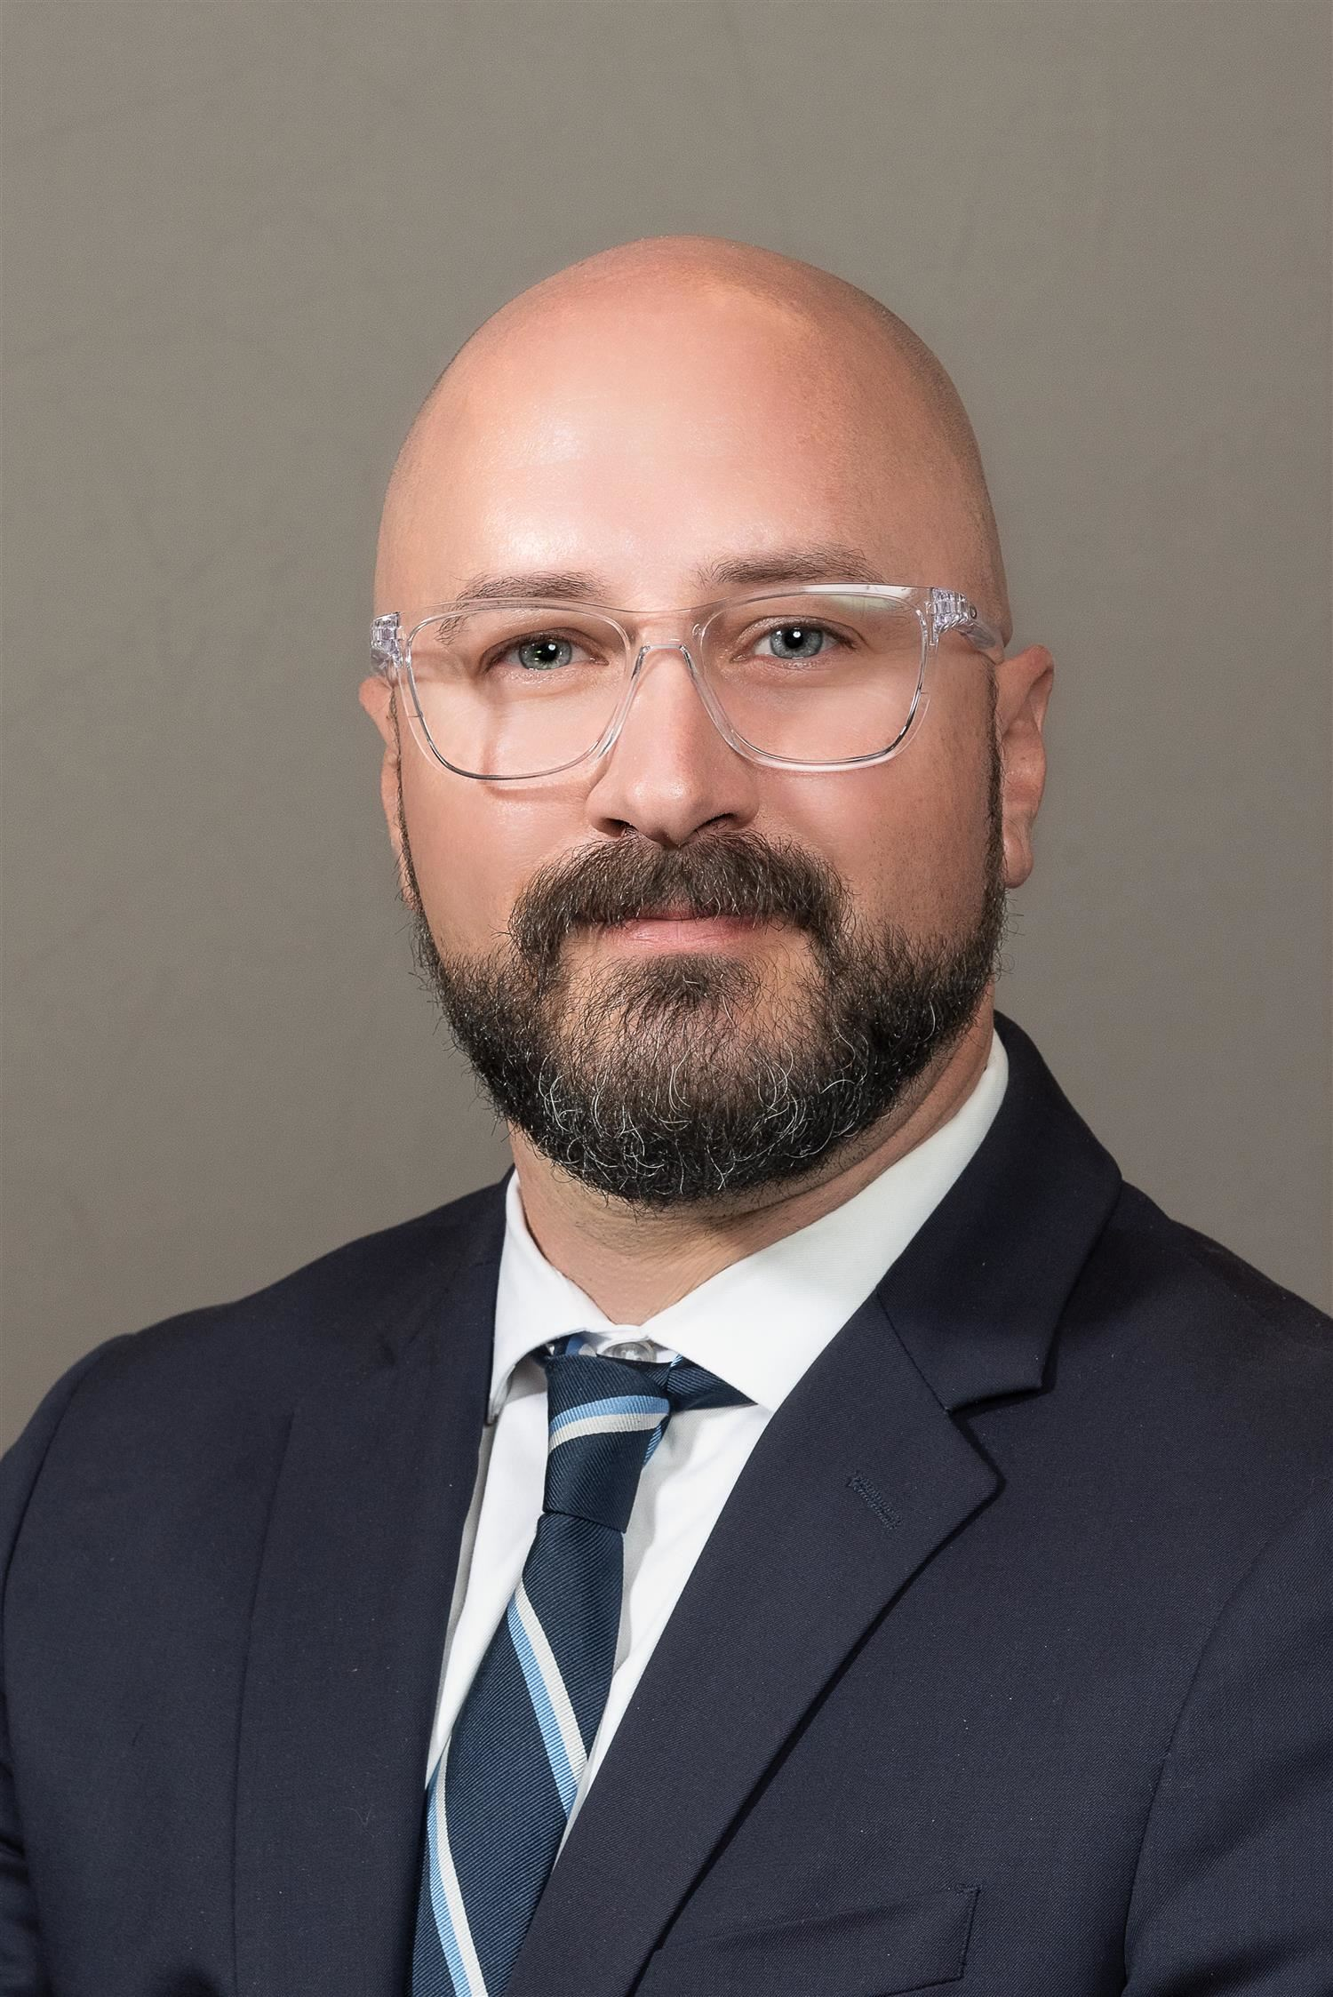

Message from
Mr. Pincelli – Principal

Slide 3
Rules for driving and parking on campus
Park in student designated lot – parking in other lots or areas is not permitted until after 3:00pm
Follow campus speed limit of 15 mph
Parking permit should always be hung from the rearview mirror and visible
Report all accidents immediately to appropriate people - Administration/Security
Do not go to your vehicle between classes or during lunch without permission from an administrator
Do not enter vehicle during school evacuations such as fire drills
Any reckless act will be reviewed by administration and security and may result in immediate loss of parking/driving privileges on our campus. This may include additional disciplinary consequences in accordance with the BCSD Code of Conduct
Notes:
Chris/Jeff

Slide 4
Rules for driving and parking on campus
Obey all traffic signs on our campus such as speed limit of 15 mph
Refrain from all forms of reckless driving: such as carrying students on hood, top or trunk of vehicle to name a few
Do not use your cell phone while driving
Do not allow any other student to drive your vehicle
Arrive on time to school/class
Leave school only with permission during the school day
Do not take students off campus during the school day
Do not drive other students to WEMOCO
Notes:
Brian

Slide 5
Consequences
Any Violation of the above regulations or the Brockport Central School District Code of Conduct may result in the Following:
1st Offense: Depending on the nature of the offense, possible loss of parking privilege on campus for a minimum of 2 weeks and possible disciplinary action.
2nd Offense: Depending on the nature of the offense, possible loss of parking privilege on campus for a minimum of 1 month and possible disciplinary action.
3rd Offense: Depending on the nature of the offense, possible loss of parking privilege for a year and possible disciplinary action.
Any violation may result in suspension of driving privileges or a disciplinary consequence (detention, suspension, etc.) at the discretion of the High School Administration or the Director of Security.
Notes:
Chris/Jeff

Slide 6
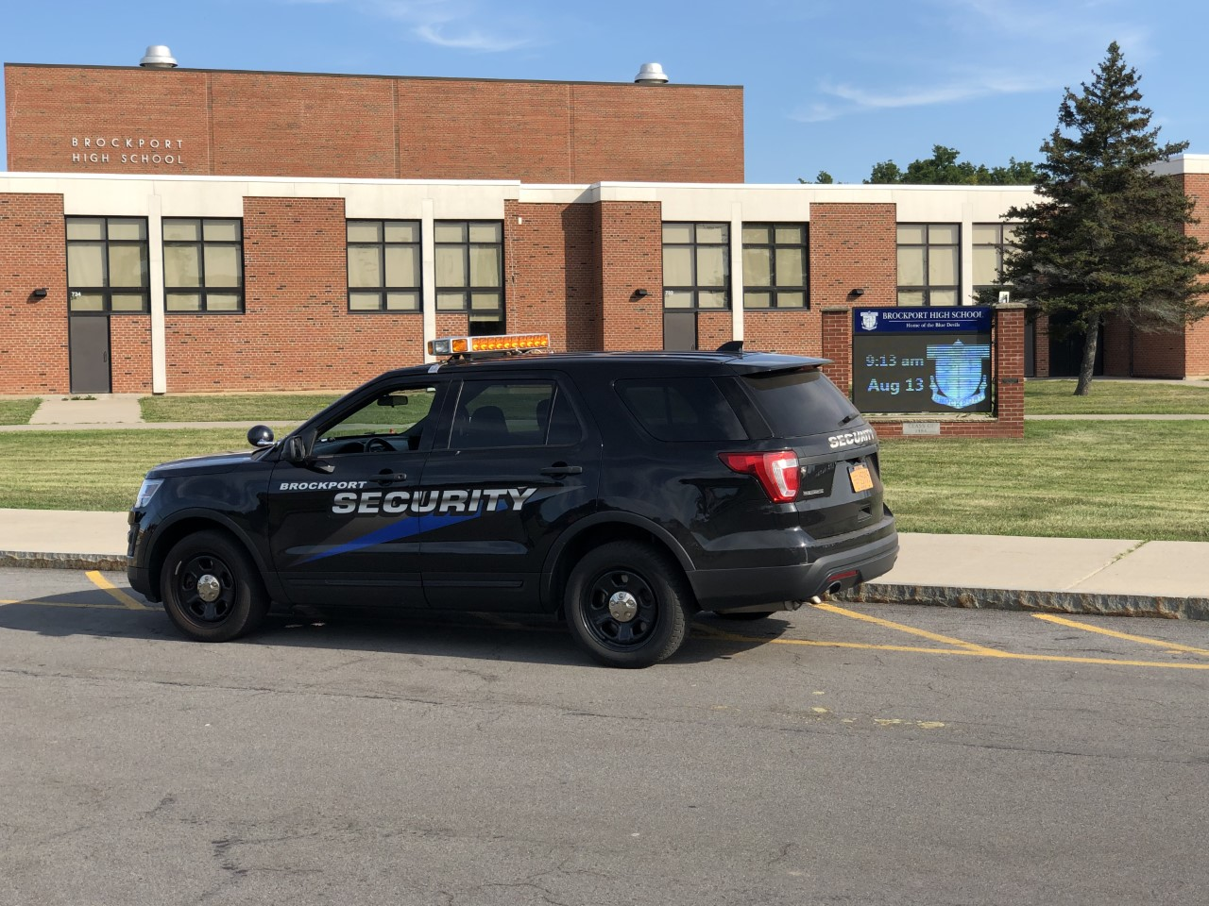
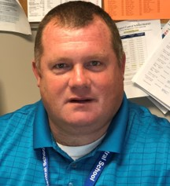
Message from Mr. Phillips
Director of Security

Slide 7
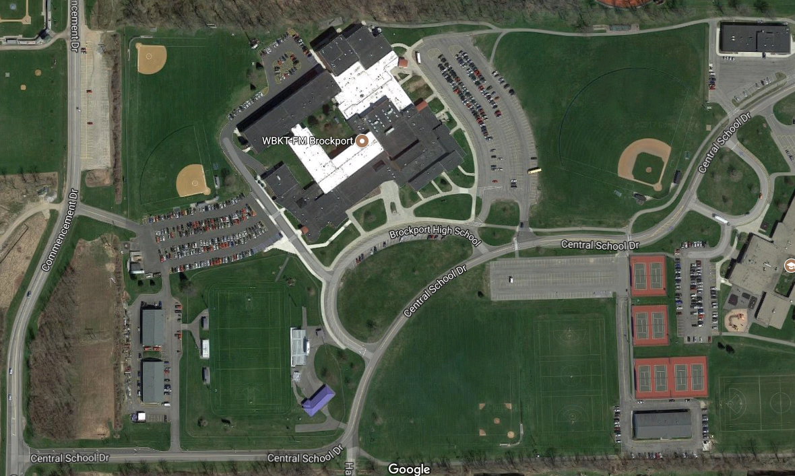
Faculty Parking – Lot B
Faculty Parking – Lot D
Brockport High School
Student Parking – Lot A
X
Overflow Parking – Lot E
X
Visitor Parking – Lot C
Notes:
Chris/Jeff

Slide 8
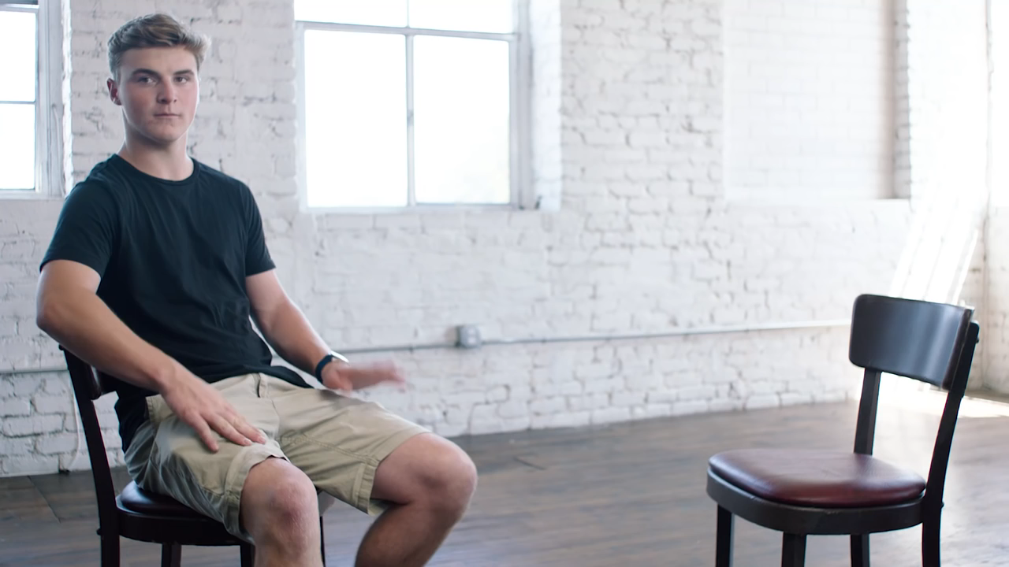
Distracted Driving Video
Notes:
Chris/Jeff

Slide 9

Distracted Driving Video
Notes:
Chris/Jeff

Slide 10
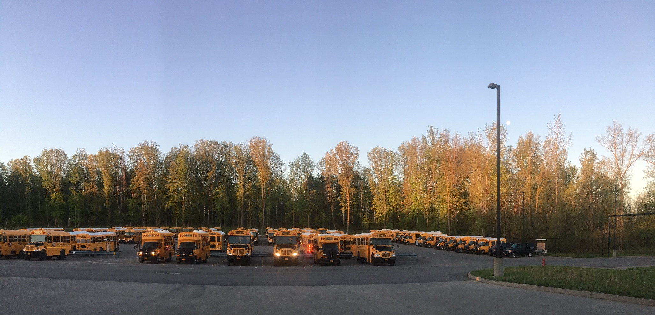
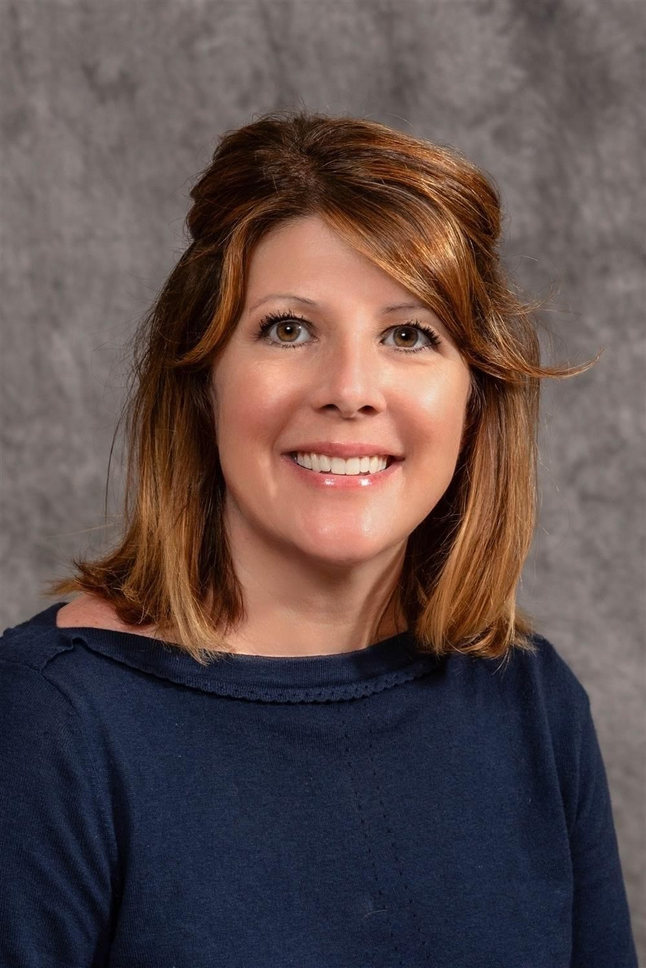

Message from Dr. Kluth,
Executive director of operations

Slide 11

School buses: what to know
- Amber lights: the bus is preparing to stop to load/unload students – you should slow down and prepare to stop.
- Red lights/stop arm: the bus is actively loading/unloading students. You must stop and not pass a bus with flashing reds.
- most fatalities with buses occur when students are loading/unloading and a car passes the bus.
Notes:
Rich

Slide 12
Tips for sharing the road with School buses
Never pass a stopped school bus, with its red lights flashing, on the
right or left
Watch for children who cross in front of the bus when the bus is stopped
Look for children at bus stops and those running to bus stops
By law, school buses are required to stop at railroad crossings
Penalties for illegally passing stopped school buses with red lights flashing are:
Notes:
Tammy

Slide 13
Parking Lot Safety and
Driver Education Program
Notes:
Rich

Slide 14
Parking Lots
~ 20 percent of all vehicle accidents happen in parking lots
Slow down
Use common sense
Expect and Be Aware of pedestrians
Parking lots are full of people coming from and going to their cars
Everyone is in a hurry to get to class or go home
It is your responsibility to look for pedestrians
Be sure to obey all crosswalks within the parking lot
When entering particularly high foot-traffic areas, take your foot off the accelerator and cover the brake

Slide 15
Distance yourself
No matter how courteous and conscientious you are when parking, you can fall victim to someone else's carelessness.
Park away from other vehicles. (Reduces risk of door dings and damage)
Don’t be that person who takes up two spaces
A scratch or an expensive car bumper can cost more than $1,000 to fix.
Cruising around the parking lot to find the best spot creates opportunities for accidents
Do not park in painted/personalized parking spaces without prior administrative approval
If you see a blank empty space, take it immediately

Slide 16
Don’t Overcrowd the car
Teens frequently overcrowd their cars, cramming five or six into a cabin meant to seat four or five
Extra passengers often result in teens driving more aggressively, speeding, getting distracted and taking unnecessary chances

Slide 17
Avoid doing the following in parking lots:
1. Texting or Social Media
2. The usage of a cellphone/smartphone/electronic technology
3. Grooming: hair, make-up, deodorant, etc.
4. Eating or drinking
5. Talking to fellow passengers in the vehicle or
another vehicle close by
6. Adjusting radio

Slide 18
Stay Alert
Parking Lot Safety tips for drivers:
Stay in lanes and avoid cutting across parking spaces
Drive slowly and use directional signals
Anticipate the actions of other drivers
Obey signs: stop, speed and no-parking sign, etc.
When backing out, be mindful of vehicles and pedestrians
Demonstrate patience
Again, USE COMMON SENSE and
DON’T BE IN A HURRY!

Slide 19
Driver Education Program
4 times a year
For information- contact:
BHS – Mr. Mallaber Dana.Mallaber@bcs1.org – Forms can be found in the main office and in room 259)
OMS - Trina Kenney trina.kenney@bcs1.org – (585) 637-1961
Also look for dates and times under the Community drop down tab on District Website www.bcs1.org
Notes:
Rich

Slide 20
Benefits of taking Driver Education
We know what to teach you for your safety and the safety of others
Teach you the Rules of the road (knowledge)
Defensive driving techniques
Personal responsibility
Help you to gain more confidence in your ability out on the road
Lower insurance premiums- (usually 10 – 25%) for 4 – 5 years
Full driver’s license at 17 instead of 18
Most importantly- Practicing good driving habits and proper etiquette while behind the wheel, keeping you and others safe!
Notes:
Rich

Slide 21
Don't forget to take your quiz
This is required
Click here to access the quiz

